Slide 1
Community-Engaged Scholarship in Performance Reviews and RPT
Diane M. Doberneck, Ph.D., connordm@msu.edu
Director for Faculty and Professional Development
Office for Public Engagement and Scholarship
Adjunct Associate Professor Department of Community Sustainability
Michigan State University
Emerging Engagement Scholars Workshop, Athens, GA
Master Class #3, 2022
Notes:
Session Timetable:
10 mins: what RPT is and how it works
20 mins: how to prepare your materials
--importance of narrative—both RPT essay & other place you promote your narrative

Slide 2

Opening Reflection…
As an engaged scholar, when you think of performance reviews and reappointment, promotion, and tenure….what thoughts or images or feelings come to mind?

Slide 3
Various Perspectives
In your own or in seeking tenure-track positions, where your job security is tied to the achievement of tenure. Understanding what the RPT process is about and what is expected will help you make strategic decisions about managing your faculty work
In university support roles where you work with faculty to encourage and support their community engaged scholarship. Understanding how they are evaluated, what counts, and the pressures they face will help you be more strategic in the support you offer
As a frequent collaborators or project partner, understand the realities and pressures that your tenure track faculty partners experience

Slide 4
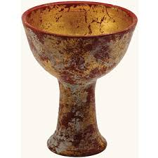
Opening Thoughts
The quest for reappointment, promotion, and tenure if often talked about in the same ways as the quest for the Holy Grail:
Shrouded in mystery
Epic journey
Unexpected pitfalls
Significant uncertainty about actually reaching the final reward, despite valiant effort
Notes:
Image is from: https://www.google.com/search?q=holy+grail+image&biw=1821&bih=889&tbm=isch&tbo=u&source=univ&sa=X&ved=0ahUKEwiupu-Ajo_NAhUFA1IKHRE4CYAQsAQIGw&dpr=0.75#imgrc=NURE6EGZla6kmM%3A

Slide 5
What is Reappointment, Promotion, and Tenure?
Faculty, peer, and administrative review of junior faculty to judge the quality of their accomplishments and the potential of their future success at the institution

Slide 6
Importance of RPT Decisions Michigan State University, 2013, pg. 2
“Decisions to promote and tenure faculty members are the most important made by the University, for they will determine the [University’s] reputation and prominence for many years to come.
Departments, schools, and colleges are expected to apply rigorous standards and to refrain from doubtful recommendations for reappointment, promotion, and tenure.”

Slide 7
Criteria and Standards Michigan State University, 2013, pg. 12
“Departments, schools, and colleges are required to base decisions for reappointment, promotion, and tenure on criteria and procedures that are clearly formulated, objective, relevant, and made known to all faculty members.”
“It is critical that faculty learn about the standards and criteria in their department/school and/or college.”
Administrative briefings (i.e., department chair)
Campus workshops
Mentoring (formally and informally)
Peer conversations (again, formal and informal)
Notes:
NOTE: As an academic or administrative staff person, it is really important that you understand these campus processes. If you are oblivious to them, your interactions with faculty on your campus will be ill-informed and naive

Slide 8
Written Policies Sometimes Include Additional Guidance
At most Colleges or Universities, RPT policies must be approved by Academic Governance. On unionized campuses, RPT policies are part of the negotiated contract between the institution of higher education and faculty.
At some universities, policies are not officially amended but institutional leaders include instructions to RPT committee members as “additional guidance.”

Slide 9

Explicit—above the water line
Implicit—below the water line
Ask lots of questions—especially of recently tenured community engaged scholars—as norms change over time.
Notes:
Image from: http://www.drclairejetha.co.uk/do-you-want-to-go-deeper-and-deeper/

Slide 10
Reappointment, Promotion, and Tenure Basics Caveat: RPT policies vary by institution—especially when it comes to CES in performance reviews and reappointment, promotion, and tenure.

Slide 11
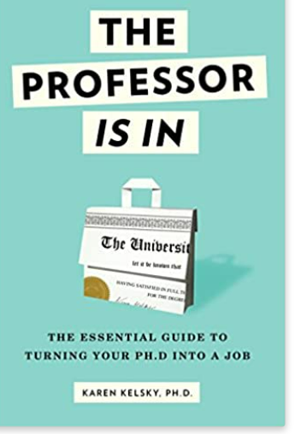
Resource: The Professor is In
Karen Kelsky
https://theprofessorisin.com/
Book
Facebook page
Workshops
Career Advice
Preparing Job Search Materials
Negotiating Job Offers
Preparing Performance Review Materials
Choosing Alternative Career Paths

Slide 12
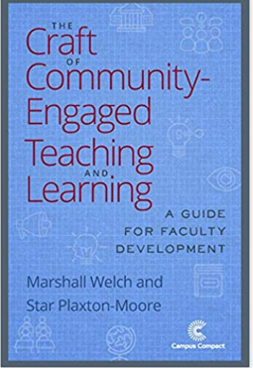
More Resources:
Nancy Franz (2011). Tips for constructing an P&T Dossier that Documents Engaged Scholarship Endeavors. Journal of Higher Education Outreach and Engagement 15(3), 15-29.
Welch, M., & Plaxton-Moore, S. (2019). Preparing for Performance Review. (chpt 12, pp. 166-188). The Craft of Community Engaged Teaching & Learning: A Guide for Faculty Development. Campus Compact.

Slide 13

Typical Review “Moments”
Assistant Professor (tenure track, pre-tenure)
Years 1-6
Reviews on big campuses take 1 year, so all materials are actually due at end of year 5 (not year 6)
Options to stop the tenure clock (family, covid)
Options to negotiate in prior or in the pipeline work when you are hired
Associate Professor with Tenure
Full Professor
Post-Tenure Review (on some campuses, not others)
Emeritus Professor—Retired Professors (not reviewed)
Notes:
NOTE: There are some advocates out there who say tenure track faculty should NOT pursue service-learning and community engagement UNTIL they achieve tenure. There are others, however, that feel that the most motivated, most diverse, incoming cohorts of faculty members will NOT be satisfied with waiting that long. In order to retain them, you need to let them pursue their scholarship in the ways that matter most to them.
This is a time of transition in Higher Education…..prudent to stay aware of the feel on your campus as a whole, and in specifid colleges or departments too.

Slide 14
Three Basic Elements
Candidate prepared materials
Personal statement, reflective essay, career statement (usually 3-5 pages describing achievements and trajectory of faculty work)
Form or Documentation in these areas:
Research or Creative Activities
Instruction, Teaching, Learning
Service, Clinical Practice
Commercialized activities (rarely)
Administrative Responsibilities (sometimes)
Grants
Publications
Curriculum Vitae

Slide 15
Committee collected materials
External reviewer letters, often at “arms length”
You might be asked to suggest people, so network and pay attention at national conferences
Department Chair, Dean letters
Review and recommendation process—multiple levels
Department
College (or Division)
University level
Board of Trustees Recommendation
State Board of Regents (in some states)
Notes:
The rest of this presentation focuses on CANDIDATE prepared materials.
As a staff person in a support role, you can keep up to date on potential “outside reviewers” if your candidate need help finding ones in their field who know about service-learning or community-engaged research.

Slide 16
The “Mix” or the “Weighting” of Faculty Responsibilities
Different emphasis or combinations across faculty responsibilities in
Research
Teaching
Service
Administration
Extension
Different emphases or combinations of traditional scholarship and community engaged scholarship.
Different ways of “integrating” or making connecting across different responsibilities

Slide 17
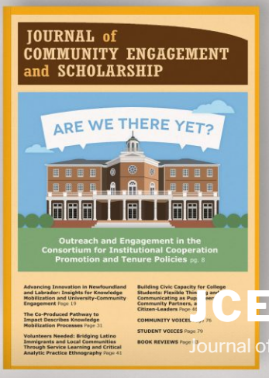
RPT Study: Big 10 Institutional Policies
May 2016
Volume 9, issue 1

Slide 18
Role of CES in RPT—Results from Big 10 Study
CIC Institution | Role of CES in RPT
Chicago | Not recognized as faculty work
Illinois, Urbana Champaign | Option to have as main focus of faculty work
Indiana | Option to have as main focus of faculty work
Iowa | Recognized but subsidiary to research and teaching
Maryland | A part of RPT reporting process
Michigan | A part of RPT reporting process
Michigan State | A part of RPT reporting process
Minnesota | Recognized but subsidiary to research and teaching
Nebraska, Lincoln | A part of RPT reporting process
Northwestern | Not recognized as faculty work
Ohio State | A part of RPT reporting process
Pennsylvania State | A part of RPT reporting process
Purdue | A part of RPT reporting process
Rutgers | A part of RPT reporting process
Wisconsin, Madison | Option to have as main focus of faculty work
Notes:
Four options:
Not recognized as faculty work
Recognized but subsidiary
A part of RPT reporting process
Option to have as main focus of faculty work
Mutually exclusive codes
3 of 15 allowed CES to be reported as the faculty member’s main focus in RPT
8 of 15 encouraged CES to be reported as part of the faculty member’s work (reflecting cross-cutting nature of CES, integration)
2 of 15 recognized CES but explicitly stated it was subsidiary to research and teaching
2 of 15 did not recognize service, outreach, or engagement as a faculty responsibility

Slide 19
Understanding Expectations
Some things “count more” than others
Publishing
Tier one, tier two, & lower journals
Impact factors
Vary by discipline
Grantwriting
Federal grants, with more overhead to the university
Even within federal funding, there is a hierarchy related to prestige
Foundation, community, or other grants, with less to the university
Student Evaluations
Awards—internal and external
Notes:
Ask LOTS of questions…..Understand what the norms are at your university, so that advice or support you give make sense given the faculty members’ situation.
For example, at MSU—federal grants, top tier research journals count.
But most faculty do NOT work at research-one institutions; most work at other types of colleges and universities.
Adelphi University (NY)…happy with 3 peer reviewed articles every 2 years (so 1 ½ year). Did NOT matter if they were top tier or not. Of course, top tier is/was better.
We have a whole session on publishing after lunch.

Slide 20

How to Prepare Materials for RPT
Take a deep breath. Remember your WHY!
Notes:
Image from: https://www.google.com/search?q=why&source=lnms&tbm=isch&sa=X&ved=0ahUKEwjTyZveqtnVAhVIzWMKHS-FAHoQ_AUICygC&biw=1920&bih=971#imgrc=wHN5nLBSZthuZM:

Slide 21
A “third” audience
As a community-engaged scholar, teacher, artist, activist, or practitioner, you are aware of and committed to sharing you work with two audiences—minimally.
Community partners, practitioners (this is part of what distinguishes you from a traditional scholar)
Disciplinary peers and colleagues
Institutional audiences are your third audience. They have a different set of priorities, are interested in different evidence, and find different narratives compelling (or not) compared to the other two audiences.

Slide 22
Importance of Documentation Driscoll & Lynton, 1999, pg. 7
“Documentation must mean more than merely listing an activity or an item on a curriculum vitae.
Adequate documentation is a combination of narrative, explanatory, and illustrative material that allows the faculty members’ peers to understand his or her purposes and processes as well as outcomes.”

Slide 23
What Might You Document About Your Own Community-Engaged Work?
Processes
Impacts or Products

Slide 24
Importance of Narrative University of Mass. Boston 2005, pg. 5
Your personal statement “provides context for your achievements beyond what is visible on your c.v., showing that they fit into a meaningful plan for your development as a scholar, teacher, and university citizen.”
Your personal statement should summarize significant achievements (looking backwards) and describe the trajectory of your scholarship (looking forwards).

Slide 25
Your Scholarly Trajectory
Past
Present
Future
Aspirations
Achievements

Slide 26
Strategy 1: CES Embedded Throughout Narrative Strategy
Entire way a scholar frames their approach to scholarship
Embedded, intertwined, or integrated throughout
More common in some disciplines (i.e., community psychology, social work, community sustainability)
More common with social justice motivated scholar-activists (i.e., I’m a critical race scholar)
More common with scholars who pursue scholarship related to their identity (i.e., I’m an indigenous scholar)

Slide 27
MSU RPT Example:
“Statement of Scholarship, Teaching, and Service
I am a woman of […] ancestry, therefore I bring with me, as a scholar and teacher, a responsibility to my […] elders to honor the rich legacy of my birth and my commitment to the […people] to build healthy productive communities of learning.
Scholarship
Scholarship of culturally relevant leadership and institutional-community engagement
During the first five years of my academic career (pre-tenure), I grappled with complex tensions of what it means to learn, teach, lead, and live as a […] woman scholar, mentor, and teacher at a Big-10 institution.

Slide 28
MSU RPT Example, Continued
My journey to build bridges between my unique perspective and more conventional approaches helped me to shape my scholarly work around three areas: (a) understanding the political-cultural implications of educational policy on native peoples; (b) exploring alternative ways of knowing and doing school leadership; and (c) defining engaged educational communities/institutions.
Over the past five-six years (post-tenure), I have worked hard to extend my lines of inquiry to explore and disseminate alternative (cultural) models of thinking and doing educational leadership. I would characterize my work as a scholar and advocate as making concrete meaning of how educational leaders (current and potential) think and are inspired to create engaged communities of learning across the lifespan that honors the principles of cultural wisdom.”

Slide 29
Strategy 2: CES in Only Some Places Narrative Strategy
Only one aspect of scholarship is framed as CES
Research
Teaching/learning
Service/practice
Appears in some sections but not others
More common in some disciplines (i.e., STEM fields as outreach teaching; health disciplines as clinical practice)
More common on some campuses that emphasize “engaged learning” (i.e., service-learning as a pedagogy; undergraduates in community-engaged research as a high impact practice)
Notes:
Tell recent horror story…..

Slide 30
RPT is an Institutional Investment in You
It’s vitally important to link your service-learning or community-engaged research directly to important questions in your field and/or innovative disciplinary approaches to teaching/learning or research.
Even better….if you can also link your community-engaged scholarship to strategic priorities of your department, college, or university overall.

Slide 31
Other Times/Places to Tell Your CES Story
Annual review documents
Department chair or dean meetings—formal & informal
Hallway conversations with departmental colleagues
C.V.
Biography
Webpage—your departments, your own
Digital Presence—LinkedIn, Webpage, guest blogs, youtube, POD casts
Departmental brown bag lunches
College or University workshops or talks
Where else?
Notes:
More on Communicating with the Public

Slide 32
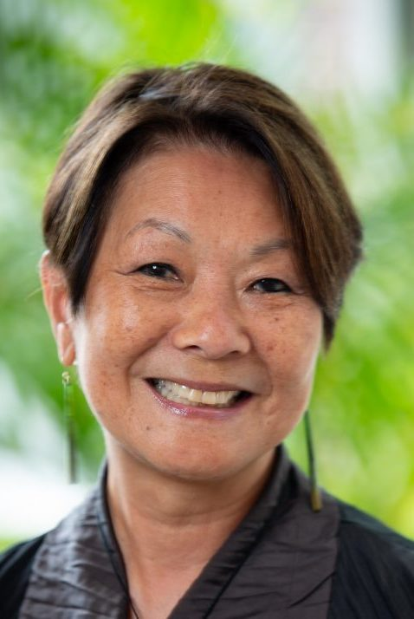
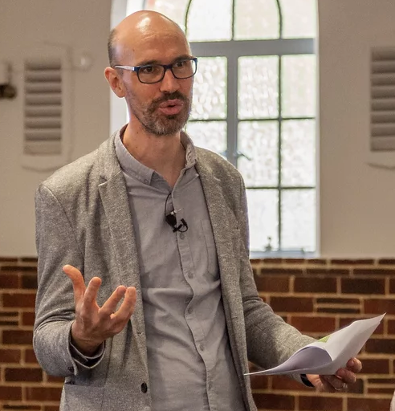
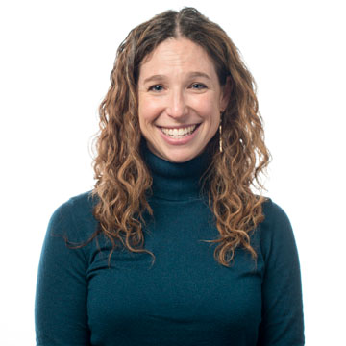
Web Presence & Community Engagement
Eugenia Eng, North Carolina-Chapel Hill
https://hpdp.unc.edu/people/research-fellows/current-hpdp-research-fellows/eugenia-eng/
Mark S. Reed, Newcastle University (UK)
What I do: https://www.profmarkreed.com/what-i-do
Publications: https://www.profmarkreed.com/journal-articles-books
Meredith Gore, Fisheries and Wildlife
http://www.conservationcriminology.com/
Eugenia Eng
Mark S. Reed
Meredith Gore

Slide 33
Link Your Story to Your Institution’s Story
Franz (2011) reminds us about the importance of understanding departmental, college, and university priorities and talking about/framing your community engaged scholarship in ways that align with those institutional priorities.
Your work can be celebrated as institutional “success stories.” Become a braggable!
College communications
University communications
Alumni communications

Slide 34
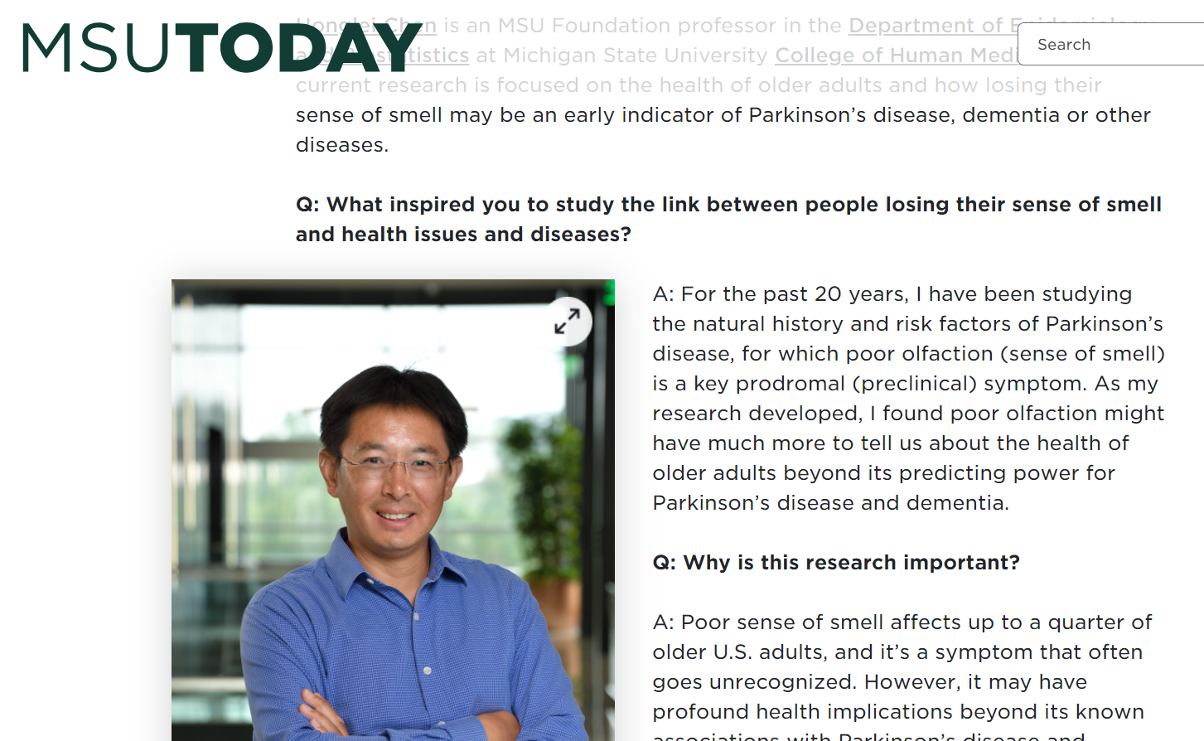
Ex: MSU Today highlights a researcher

Slide 35
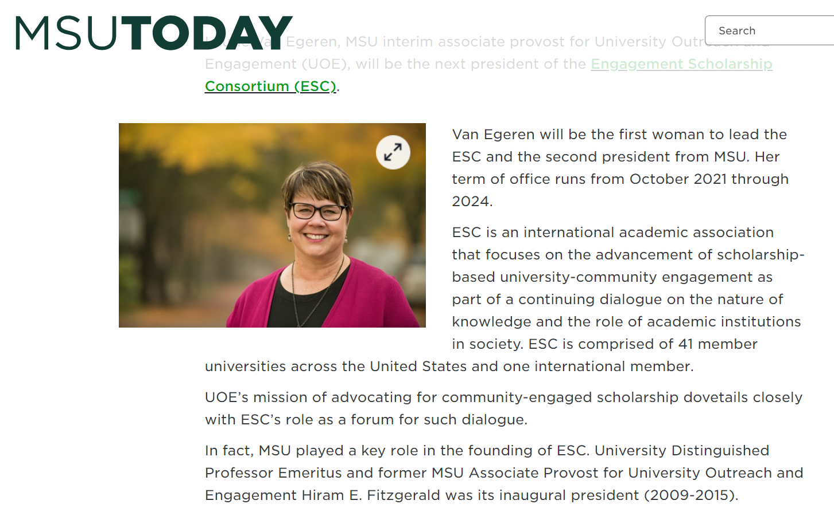
Ex: MSU Today highlights CE Leadership

Slide 36
Strategies Calleson, Kauper-Brown, & Seifer, 2005
Create a hybrid or mixture of traditional and community engaged scholarship
Match your appointment percentages, advice
Publish and present your community engaged scholarship
Write about the process
Look for special editions or themed journals about community engaged scholarship
Community engagement
Generate multiple types of products across the academic missions
Solicit peer review of applied products
Measure impact in the community and the academy

Slide 37
Advice from MSU recently tenured CE Faculty
Bring up your community-engaged work & talk about yourself as a community-engaged scholar every chance you can
Think about the person you are talking to & emphasize different CE points
Department chair—grants, student evaluations
Provost—community engagement and students
Cultivate a cheering support team—have them talk you up, so you aren’t always having to talk yourself up. Have some of these people be outside of your department and college.
Have your work known by others in your department and college, so when your materials come up for review, you are a known (not unknown) person
Link your community engagement to key questions in your discipline or fields

Slide 38
Link Your Review Materials to Institutional Plans and Policies
Remember this is a 3rd audience (institutional leadership)
What links can you make between your work and….
University strategic plan
College or departmental strategic plan
University Outreach and Engagement strategic plan
Extension strategic plan or priorities
Undergraduate learning goals/outcomes
Diversity, equity, and inclusion plans
What else?

Slide 39
Solicit Peer Review of Applied Products
Solicit review by well recognized academic and community leaders—through a blinded process
Work with Extension, if applicable, for review of your products and projects
Submit your Community Engaged Teaching Syllabus to Campus Compact for their review and national dissemination
Apply for college, university and disciplinary society awards that acknowledge excellence in community-engaged scholarship

Slide 40
Apply For National Awards, Start the habit as a graduate student
Engagement Scholarship Consortium
https://engagementscholarship.org/grants-and-awards/esc-awards-program
IARSLCE
https://www.researchslce.org/recognitions#:~:text=In%20recognition%20of%20exemplary%20contributions,approaches%20and%20all%20educational%20sectors.
PAGE Fellow Imagining America
https://imaginingamerica.org/what-we-do/fellowships/page/

Slide 41

RPT Narrative Worksheet

Slide 42
Pause to Reflect…
What are one or two new things you learned about preparing for performance reviews and/or RPT?
What are next steps you’ll take?
What opportunities does the ESC conference hold for you to learn more about navigating performance reviews and RPT?

Slide 43
References
Calleson, D., Kauper-Brown, J., & Seifer, S.D. (2005). Community-Engaged Scholarship Toolkit. Seattle, WA: Community-Campus Partnerships for Health. Retrieved from: https://ccph.memberclicks.net/ces-toolkit.
Doberneck, D. M. (2016). Are we there yet?” Outreach and engagement in the Consortium for Institutional Cooperation Promotion and Tenure Policies. Journal of Community Engaged Scholarship 9(1), 8-18.
Driscoll, A.,& Lynton, E. (1999). Making outreach visible: A guide for documenting professional service and outreach. Washington, DC: American Association for Higher Education.
Franz, N. K. (2011). Tips for constructing a promotion and tenure dossier that documents engaged scholarship endeavors. Journal of Higher Education Outreach and Engagement 15(3), 15-29.

Slide 44
References, Continued
Freeman, E., Gust, S., & Aloshe, D. (2009). Why faculty promotion and tenure matters to community partners. Metropolitan Universities 20(2), 87-103.
Glassick, C. , Huber, M., & Maeroff, G. (1997). Scholarship Assessed: Evaluation of the Professoriate. San Francisco, CA: Jossey Bass.
Jordan, C. (Ed.) (2007). Community engaged scholarship review, promotion, and tenure package. Peer Review Working Group. Community Engaged Scholarship for Health Collaborative, Community-Campus Partnerships for Health. Retrieved from: https://depts.washington.edu/ccph/pdf_files/CES_RPT_Package.pdf.

Slide 45
References, Continued
Seifer, S. D. (2007). Making the best case for community-engaged scholarship in promotion and tenure review. In M. Minkler & N. Wallerstein (Eds.). Community-based Participatory Research for Health: From Practice to Outcomes, 2nd edition (pp. 425-430). San Francisco, CA: Jossey-Bass.
University of Massachusetts-Boston, CLA Tenure Track Faculty Task Force. (2005). On Track Suggestions and Information for Faculty Anticipating Fourth Year or Tenure Review in the College of Liberal Arts. Retrieved from: https://www.umb.edu/academics/cla/info_for_faculty/junior_faculty_task_force.

